Slide 1
Cab Industry Investment Analysis
G2M Use Case - Week 3
Presented by: Jenisa Thapa
April 2025

Slide 2
Business Problem
XYZ is a private investment firm exploring opportunities in the U.S. cab industry.
Due to rapid industry growth and competition between companies, they want to identify:
Which cab company is more profitable
Which company has a stronger customer base
Which one offers the best long-term investment potential
Goal: Use data-driven insights to support an informed investment decision.

Slide 3
Datasets Used
1. Cab_Data.csv
Ride details: date, city, km traveled, price, cost, company name
2. Transaction_ID.csv
Links transactions to customers + payment method
3. Customer_ID.csv
Demographics: gender, age, monthly income
4. City.csv
City population + total cab users
Time Range: January 2016 – December 2018

Slide 4
Data Preparation & Cleaning
Cleaned and merged four datasets using Transaction ID, Customer ID, and City name
Converted Excel-style dates to standard date format
Converted city population and user counts to numeric
Verified no missing or duplicate data
Added new columns (e.g. Month) for seasonal analysis
Final merged dataset: ~3.5 years of ride and customer data

Slide 5
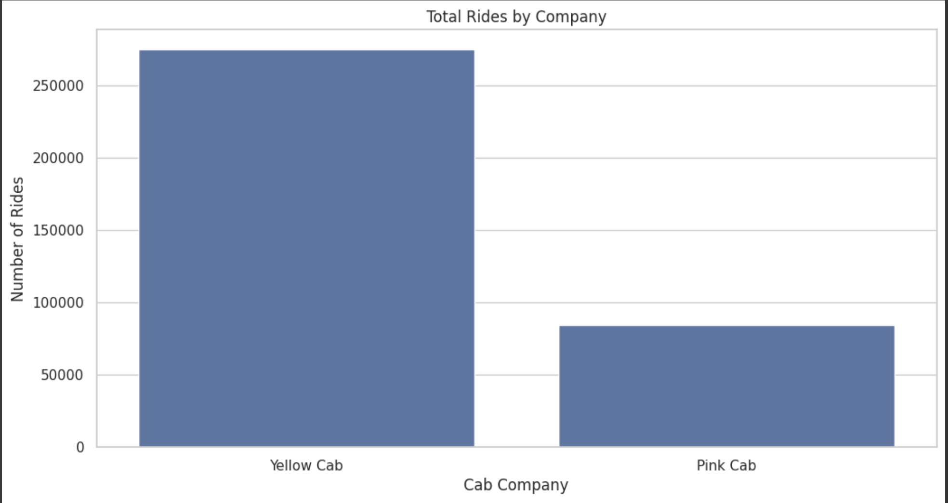
Ride Volume by Company
Yellow Cab completed significantly more rides than Pink Cab across the dataset.
Indicates stronger customer base and higher demand.

Slide 6
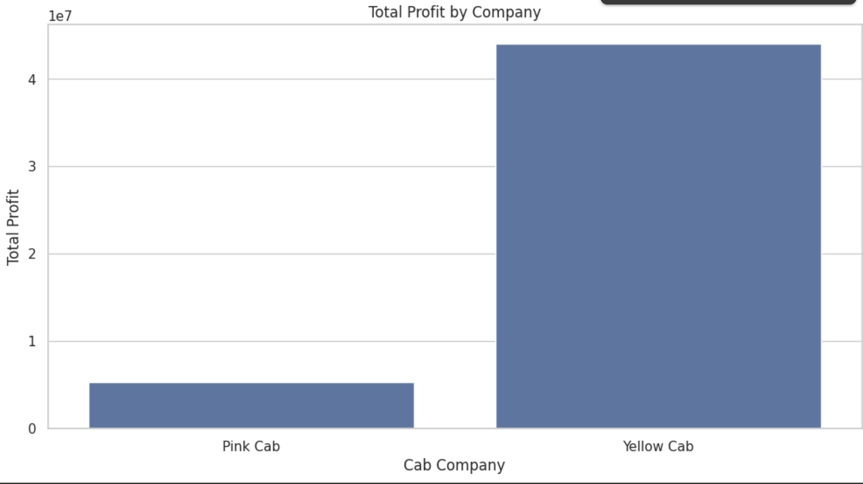
Total Profit by Company
Yellow Cab generated significantly higher total profit compared to Pink Cab.
This indicates stronger margins and better overall financial performance.

Slide 7
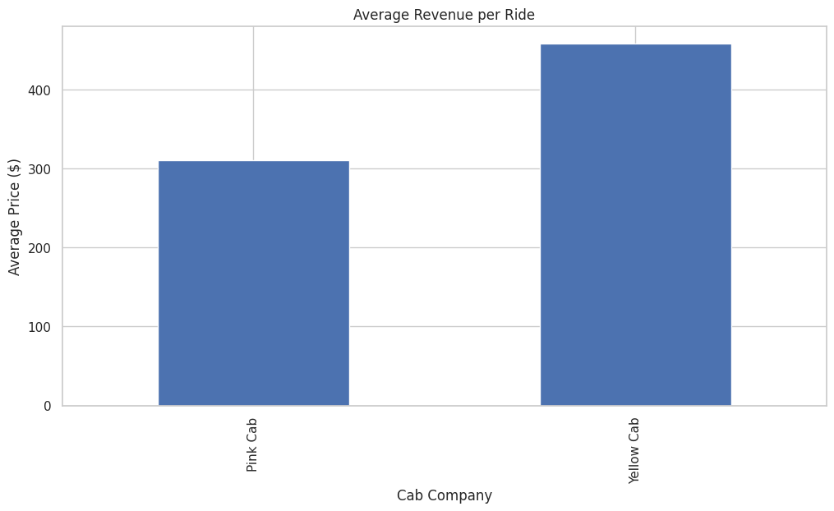
Average Revenue per Ride
On average, Yellow Cab earns more per ride than Pink Cab.
This may reflect longer distances, premium pricing, or market differences.

Slide 8
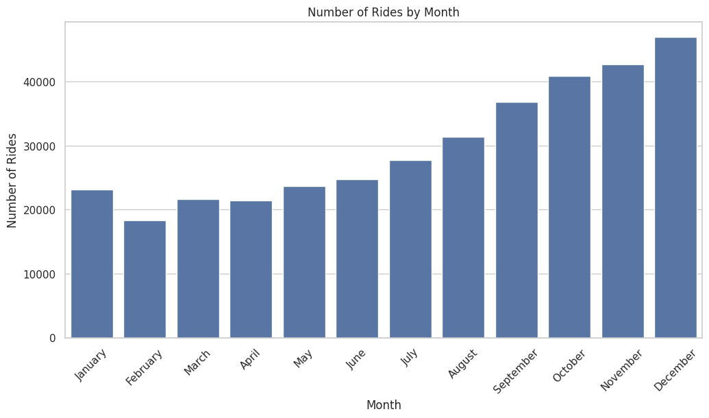
Monthly Trends in Ride Volume
Ride volume shows seasonal patterns, with noticeable fluctuations across months.
Indicates potential for demand-based strategies or targeted promotions.

Slide 9
Investment Recommendation
Based on ride volume, revenue, and profitability analysis:
Yellow Cab is the stronger investment opportunity.
Reasons:
Significantly higher total rides and profit
Higher revenue per ride
Consistent seasonal growth
Stronger market presence across cities
Pink Cab may still offer niche value, but Yellow Cab presents better overall returns.

Slide 10
Thank You!
Jenisa Thapa
Email : jenisathapa.05@gmail.com

